Slide 1
Reimagining
Asteroids
A product reveal and process reflection by SEM project group 60:
Marijn “Mac” Craenen, Jasmine Diaconu, Nathan Kindt, Pepijn te Marvelde & Timea Nagy
Notes:
How does one recreate a classic arcade game, without losing that charm which made it popular so many years ago?
SEM 60
Reimagining, modernizing, today's standards, without losing its identity
Showcase product - Share original visions - explain process - reflect on the journey
Four colleagues

Slide 2
Designing Asteroids
Historic origins
Development process
Implementation
Demonstration
Uniqueness
What’s next?
Notes:
TALK NOTES:
Start things off, we will provide you with the historical context about asteroids.
Guide you through the development process
and explain the implementation of some features.
Followed by a quick demonstration and
As to then briefly discuss what makes it unique,
as well as future plans and reflect
Around 15 minutes, feedback / ask questions
Now, I would like to welcome forward Jasmine

Slide 3
Historic Origins
Notes:
Switch speaker, scene transition

Slide 4
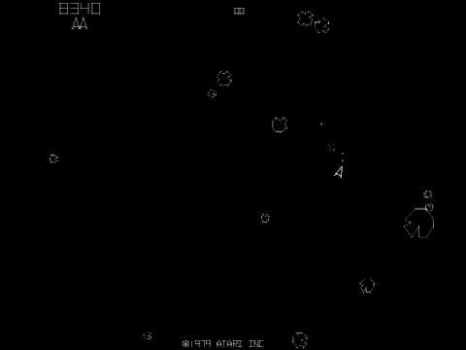
History
Asteroids is an arcade game, invented and released by Atari in 1979.
Figure 1. Arcade Game: Asteroids -
https://i.ytimg.com/vi/9Ydu8UhIjeU/hqdefault.jpg
Asteroids game, 1979 version
Notes:
Now that we saw the development process you might wonder where does the idea comes from.
The original Asteroids is dated back to 1979, released as an arcade game by Atari.
Here on the right we have a picture of this version.

Slide 5
Plot
Simple game concept:
One player
Asteroids
Shoot the asteroids to win
Figure 2: Asteroids gameplay - https://thumbs.gfycat.com/CrispWelllitBrocketdeer-max-1mb.gif
Notes:
It’s gameplay is very simple: there is a player (represented by a spaceship) and asteroids that appear on the screen. The goal of the player is destroying as many asteroids as possible and, of course, trying to avoid collisions!
Whenever an asteroid gets hit, based on its dimension, it will either disappear from the screen or it will split into smaller asteroids as we can see from this animated image on the right.
That’s how the game increases in difficulty.

Slide 6
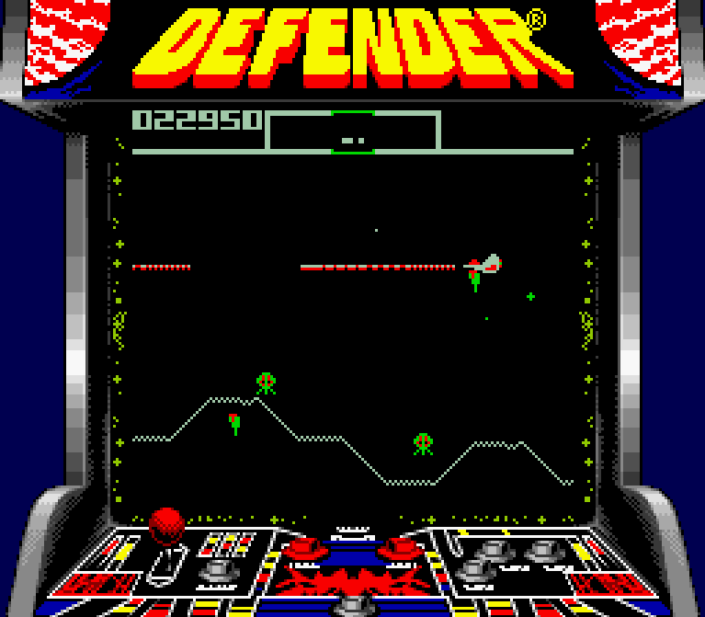
Success
Sales: over 70,000 arcade cabinets sold
Sequels:
Asteroids Deluxe (1981)
Blasteroids (1987)
Influenced games:
Defender
Gravitar
Figure 3. Defender arcade game -
http://soundwavestv.com/2010/09/16/defender/
Notes:
But there is more because a simple game like this got rewarded with a huge success.
That is proved by its sales, sequels and influenced games, such as Defender and Gravitar.

Slide 7
Development process
Requirements
Notes:
Switch speaker, scene transition

Slide 8

MoSCoW
Must Have
Should Have
Could Have
Won’t Have
Figure 4. Anna Shagova - Moscow Method https://dribbble.com/shots/6414497-MoSCoW-Method
Notes:
The MoSCoW method is a prioritization technique we employed.
Office chair:
M - Seat, legs, backrest
S - Armrests
C - Armrest cushions
W - Footrest

Slide 9
A few of our requirements
Must have Should have
Create an account and authenticate
Player can accelerate and rotate
Player can fire weapon forward
Game will have asteroids that move around the game screen
The game screen will wrap-around
The game shall have two types of flying saucers
Notes:
I’ll illustrate a few of these requirements
Go over must haves, should haves

Slide 10
A few of our requirements
Could have Won’t have
The game shall play sound effects
The player can pause the game
The game shall have multiplayer functionality
Notes:
… blabalbla ...

Slide 11
Development process
SCRUM
Notes:
Switch speaker, scene transition

Slide 12
Our methods
SCRUM methodology
2 week sprints
SCRUM board
Notes:
-we had the requirements in the backlog
-every 2 weeks chose tasks from there to work on
-at the end we reflected on the 2 weeks
-had a working version
-then we started again

Slide 13
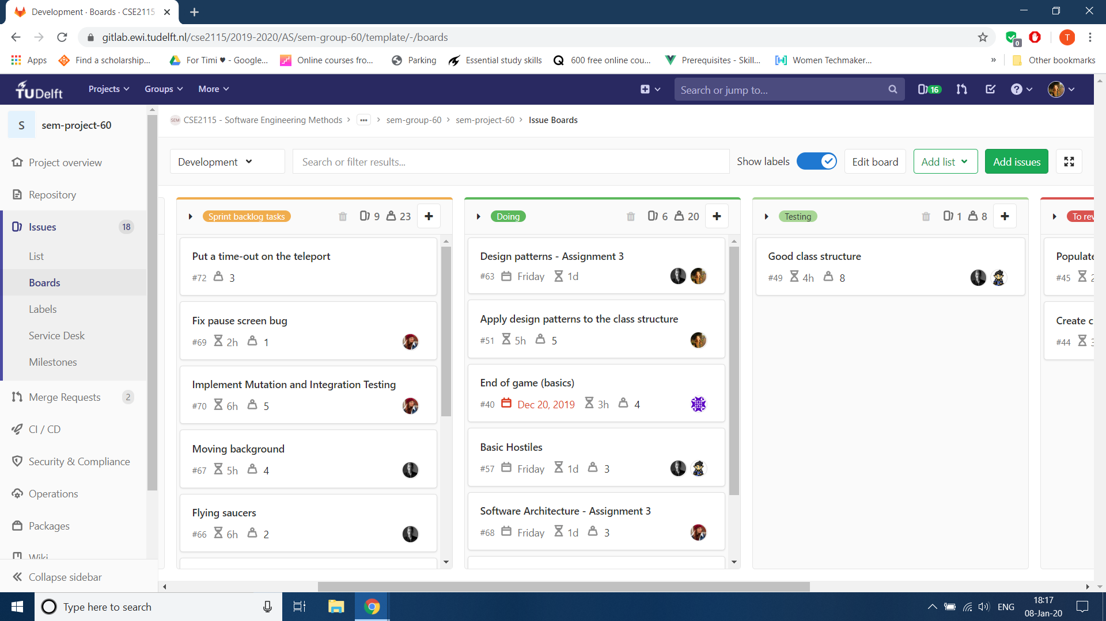
Use of SCRUM board
Backlog Doing Testing
Notes:
-visualisation of the progress, of tasks
-can see what everyone is working on

Slide 14
Backlog
Doing
Notes:
-In the sprint backlog we have all the tasks that we are aiming to do in the following 2 weeks
-Then we have the Doing category, here we can see what is currently being worked on

Slide 15
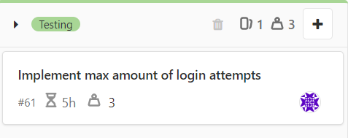
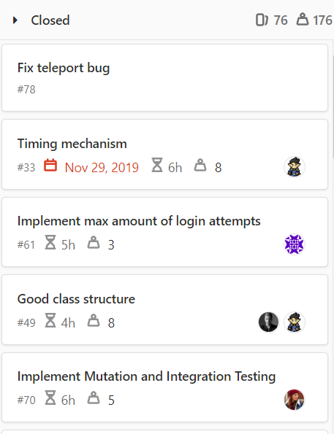
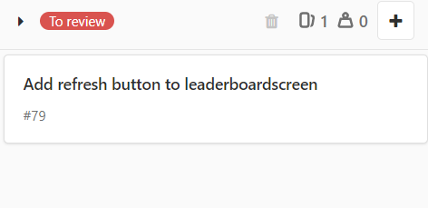
Testing
Closed
To review
Notes:
- After that a task goes into Testing, where, it is currently being tested
-and then it needs to be Reviewed
-If after the review it is concluded that everything works well, the issue is then closed, the task is done.

Slide 16
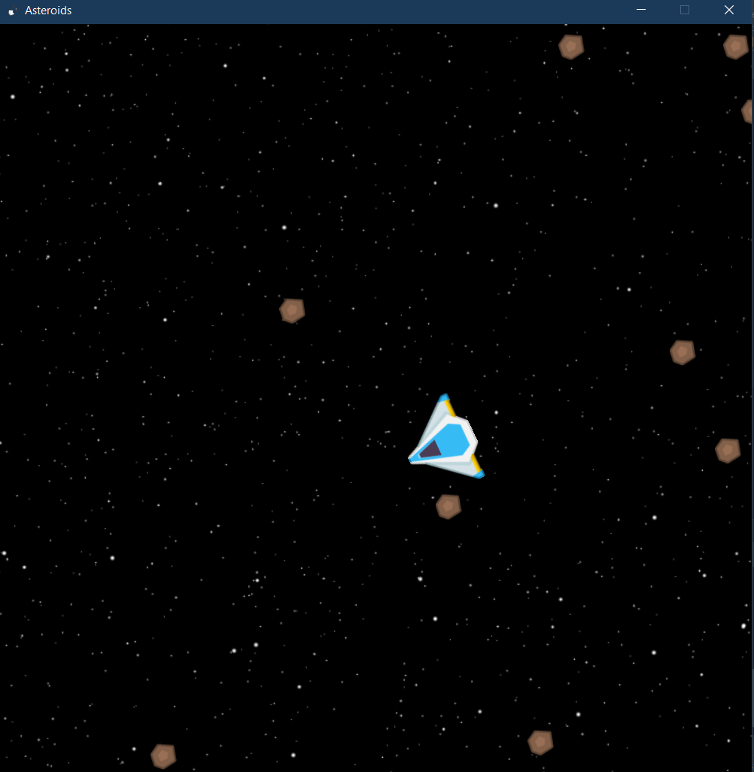
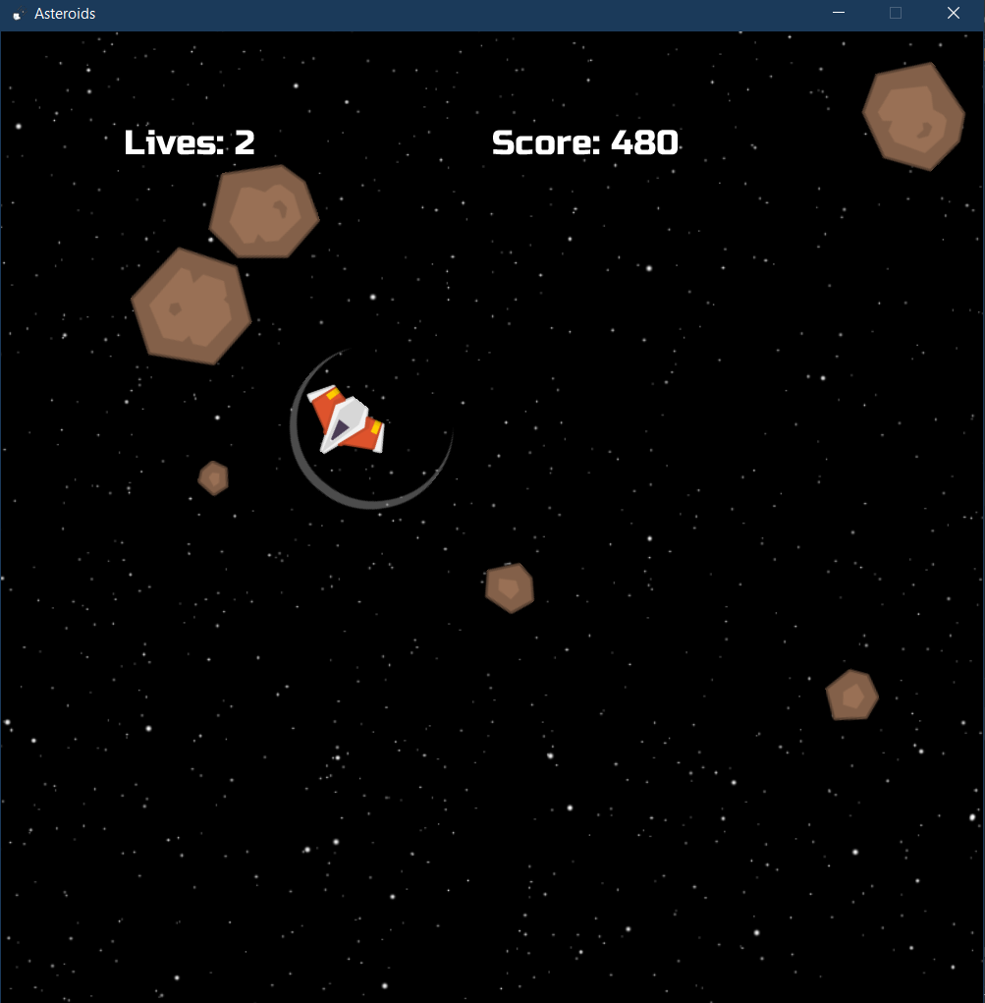
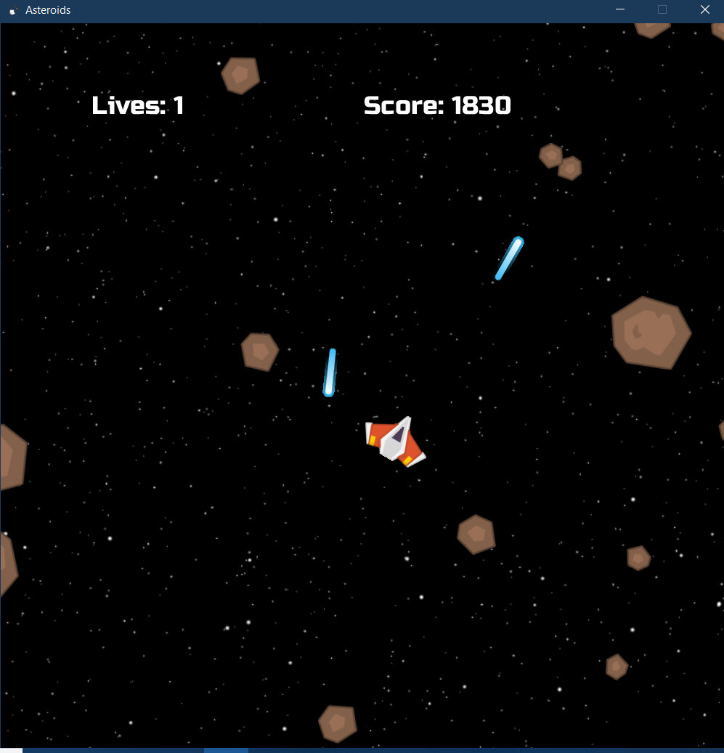

Incremental process
End of Sprint 1
End of Sprint 2
End of Sprint 3
Notes:
-here you can see what our game looked like at the end of each iteration
-1: at the beginning we only had a few basic elements -2: added more functionality, like the player’s life and different sizes of asteroids -3: final, complete product

Slide 17
Benefits
Always had a working version
Testing could be done along the way
Changes are easier to make
Notes:
-SCRUM made our development process smoother
-1: even the first prototype already resembled an Asteroid game -2: didn’t have to test a massive codebase at the very end of the process
-3: found bugs or we realised that refactoring is needed because of poor choices made at the beginning -> easy to make the necessary changes

Slide 18
Hurdles
Planning first, implementation later
Efficient task division
Testing on time
Notes:
-we were very eager to build the game, so started coding, didn’t think about structure, architecture
-At the beginning we didn’t have enough work for 2 weeks, some tasks overlapped
- Didn’t start testing early enough so we caught some bugs too late

Slide 19
Solutions
Test along with implementation
More tasks with clearer descriptions
Plan ahead
Notes:
-made a rule: only well tested code could be submitted
-came up with more tasks so surely everyone had something to work on, divided them
-clearer descriptions -> there was no room left for confusions
-for future projects: plan the architecture of the game and the overall structure of it before starting to code

Slide 20
Implementation
Notes:
Switch speaker, scene transition
Having seen our development process and why our game is unique, I will illustrate some of the inner workings of the product

Slide 21

Product Mechanics
Authentication
Salted hash password
Lockout
Alias
Figure 5. Adding Salt to Hashing -
https://auth0.com/blog/adding-salt-to-hashing-a-better-way-to-store-passwords/
Notes:
Authentication:
Salted hash password
random bits are salt
HP = H( salt . password)
Lockout
Alias

Slide 22
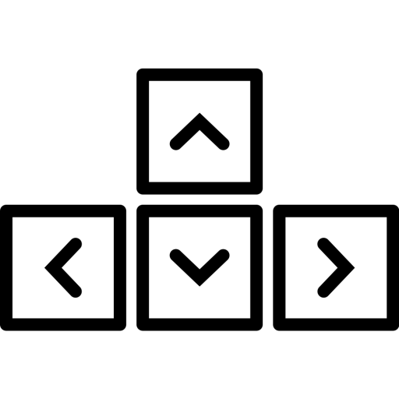
Product Mechanics
Controls
Arrow keys
Space to fire
Teleport
Figure 6. Arrow keys icon - https://thenounproject.com/term/arrow-keys/264898/
Notes:
Controls:
Arrow keys & space to fire
Most intuitive
Teleport
Adds interesting extra mechanic

Slide 23




Game Mechanics
Asteroids
Score differences
Splitting
Notes:
Different sizes and speeds
Different scores
They split

Slide 24


Game Mechanics
Lasers
Player lasers wrap
UFO lasers don’t
Notes:
Lasers
Player wrap
Ufo no wrap

Slide 25
Demonstration
Notes:
Thanks Nathan for that in depth look into some of our game mechanics, now let’s see them in action!
Now that you’ve seen our game in action Jasmine will tell you why our game is unique. Jasmine:..
Demo:
Show register, go back to login and login.
Show leaderboard.
Mention store is still in development.
Play the game:
Move around a bit
Shoot
Hostiles
Die to show shield
Save score
Show leaderboard again to show new saved score.

Slide 26
Uniqueness
Notes:
Switch speaker, scene transition

Slide 27
Why is our game unique?
Portability
Feelings
Notes:
So we talked about the development process but I am pretty sure you’re most probably interested in hearing why you should buy OUR game version.
Well, there are different factors that make our game unique and I decided to enclose them in two words. Portability and feelings.

Slide 28
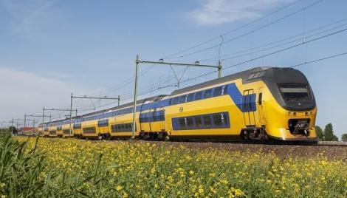
Portability
You can play anywhere!
No internet required
No hardware requirement
Imagine being on the train coming back from
work, you can relieve your stress by playing Asteroids!
Figure 7. NS VIRM- https://cdn.happyrail.com/images/cropped/800/500/uploads/landingpage_images/fl02_1186_020609_lr_1.jpg
Notes:
Portability means that you can play anywhere
First of all, you won’t need to proceed to the arcade or buy an expensive console, you don’t even need the latest graphic card or the most powerful CPU.
To run our game you can just use a simple computer!
Moreover, you can play locally, which means that you don’t need an internet connection either.
Imagine you’re on the train, coming back from work and you have to kill the time: you can just open your laptop and play Asteroids!

Slide 29
Feelings
Hardware changes, graphics get better and audio improves but what made a game great in 1979 still makes it great in 2020
Notes:
Hardware changes, graphics get better and audio improves but what made a game great in 1979 still makes it great in 2020.
It doesn’t matter if you are a gamer of the past or not. If our game won’t bring up childhood memories, it will make you feel the same emotions for the first time.

Slide 30
What’s next?
Notes:
We’re really happy with how our game turned out. There are however a lot of things we want to add or change to further improve our product.
To not bore you with an endless list of our ideas we have I’ll highlight what we think are the 2 most exciting things that we want to add to our game are.

Slide 31
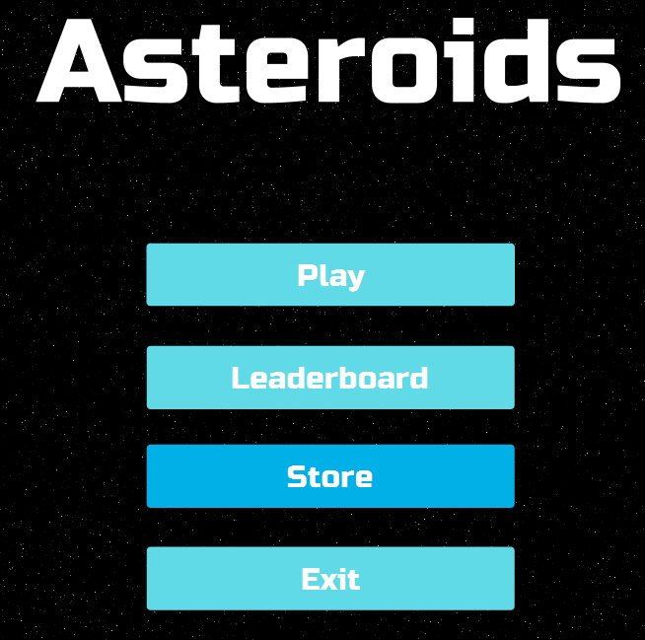
What’s next?
Store
Power-ups
Spaceships
Notes:
Let’s start with one of the “bigger” ideas we have. It’s a store where the player can buy power-ups with points they have earned by playing the game.
There will be multiple different power ups available like a laser upgrade that changes the fire rate of the player’s ship and a shield upgrade that makes the shield last longer.

Slide 32
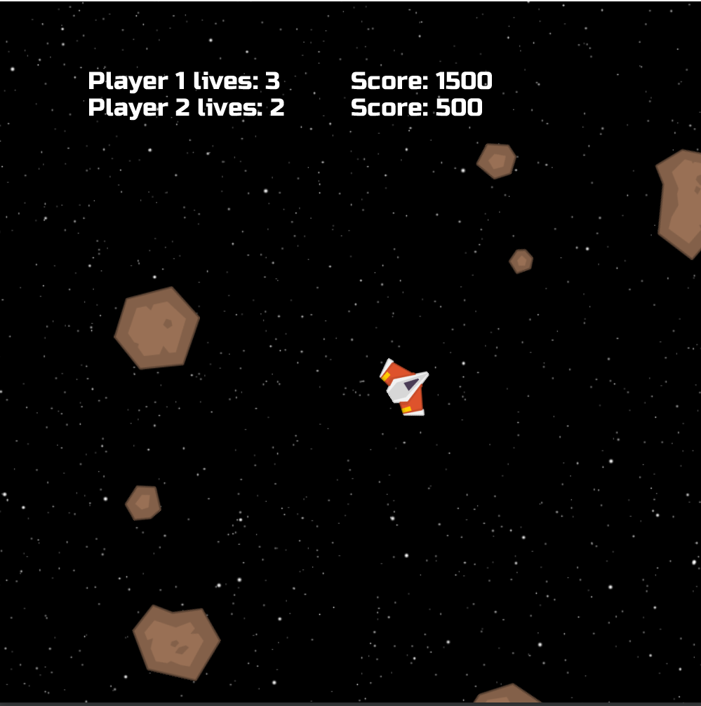
What’s next?
Local multiplayer
2 Players on 1 device
Notes:
The second idea I want to highlight is local multiplayer functionality. This means that two people will be able to compete against each other on 1 device.
We would achieve this by having one player use the wasd and surrounding keys and the other would use the arrow keys.
You’ll have to try to beat your opponent by staying alive longer and ultimately earning more points.
Reconnect to purpose statement:
To reimagine classic arcade games and bring them to modern standards, without losing their unique identity
We believe a store for power ups, and a local multiplayer mode will really make our game even more exciting than the original Asteroids, while still keeping all the key aspects that make Asteroids fun to play.
(Now Nathan will briefly summarise our main points and wrap up our presentation)

Slide 33
What’s next?
Future projects
Plan better
Follow SCRUM more closely
Notes:
Beginning own project, issues with tools
Start with architecture design / plan p
Planning
Follow scrum more closely
Look ahead to prevent issues in the future (design patterns)
We had a rough idea of how we wanted our game to look. But we would have gotten further in less time if we started planning further ahead.
System architecture
Plan better
Eager to start coding
Started separate components, didn’t fit together
Not only plan current sprint, but plan the whole system architecture

Slide 34
Reflection

Slide 35
Reflection
Sprint retrospective
Importance of planning
Future projects
Notes:
What we learned during the course
Design patterns
Team management

Slide 36
Conclusion
Notes:
NOTES:
Reached the end
So how did we modernize Asteroids?
Showed you how we applied scrum
Hurdles and solutions
Showcased it
Features and visions
And that's how we recreated a game out of the golden age of arcade, modernized it, reimagined it, and without losing its charm.
And that’s how we recreated a classic arcade game, without losing its charm that made it popular so many years ago?
Announce conclusion
Self explanatory
Summary
(I first need the content of the body to construct this.)
Conclusion
We are amazing and we all deserve a very much high grade for our game ^^
Wrap up
Self explanatory
Circle technique : (How does one recreate an classic arcade game, without losing its charm that made it popular so many years ago?)
And that's how we recreated a game out of the golden age of arcade, modernized it, reimagined it, and without losing its charm.
Analyze, fantasize, modernize!
DRAFT
Thank you very much (previous speaker), with that I believe we have reached the end of our presentation.

Slide 37
Reimagining
Asteroids
A product reveal and process reflection by SEM project group 60:
Marijn Craenen, Jasmine Diaconu, Nathan Kindt, Pepijn te Marvelde & Timea Nagy
Notes:
Reimagining Asteroids

Slide 38
Sources
SCRUM:
What Is Scrum Methodology? (2019, January 15). Retrieved January 20, 2020, from https://resources.collab.net/agile-101/what-is-scrum
What is Scrum? (n.d.). Retrieved January 20, 2020, from https://www.scrum.org/resources/what-is-scrum
Atlassian. (n.d.). Scrum - what it is, how it works, and why it's awesome. Retrieved January 20, 2020, from https://www.atlassian.com/agile/scrum
MoSCoW:
10 MOSCOW PRIORITISATION. (n.d.). Retrieved January 20, 2020, from https://www.agilebusiness.org/page/ProjectFramework_10_MoSCoWPrioritisation
What is MoSCoW Prioritization?: Overview of the MoSCoW Method. (n.d.). Retrieved January 20, 2020, from https://www.productplan.com/glossary/moscow-prioritization/
Notes:
Source page (not shown unless asked to show)

Slide 39
Sources
Images
Arcade Game: Asteroids. Retrieved from https://i.ytimg.com/vi/9Ydu8UhIjeU/hqdefault.jpg
Asteroids gameplay. Retrieved from https://thumbs.gfycat.com/CrispWelllitBrocketdeer-max-1mb.gif
Defender arcade game. Retrieved from http://soundwavestv.com/2010/09/16/defender/
Anna Shagova - Moscow Method. Retrieved from https://dribbble.com/shots/6414497-MoSCoW-Method
Adding Salt to Hashing. Retrieved from https://auth0.com/blog/adding-salt-to-hashing-a-better-way-to-store-passwords/
Arrow keys icon. Retrieved from https://thenounproject.com/term/arrow-keys/264898/
NS trein. Retrieved from https://cdn.happyrail.com/images/cropped/800/500/uploads/landingpage_images/fl02_1186_020609_lr_1.jpg

